Slide 1
Data Analysis Capstone Project
Focus on New York City's Leading Causes of Death
Source : NYC Open Data https://data.cityofnewyork.us/Health/New-York-City-Leading-Causes-of-Death/jb7j-dtam
This dataset is composed of 1,803 rows and 7 Columns Each row is a Cause of Death
Sylvia Rezk
Notes:
Entered text
some definitions:
the death rate is the ratio of deaths to the population of a particular area or during a particular period of time, usually calculated as the number of deaths per one thousand people per year.
Death Numbers refer to the absolute count of deaths within a given time period.
The choice between using death numbers or death rates depends on your specific research question and goals. If you're interested in understanding the overall impact of a cause of death and how it's changing over time, death numbers might be more suitable. On the other hand, if you want to compare the relative risk of death while accounting for population changes, death rates would be more appropriate.
In some cases, it might also be helpful to use both death numbers and death rates to provide a more comprehensive understanding of the trends in mortality associated with a specific cause over time.

Slide 2
Motivation:
NYC is a diverse City with unique health challenges.
Analyzing leading causes of death can uncover urban health patterns specific to the city's population.
Data analysis empowers evidence-based decision-making.
Studying causes of death aids epidemiologists in tracking disease trends.
Early detection of emerging health issues is vital for timely intervention.
Developing predictive models can aid in forecasting future health trends.
Preparedness for potential health crises can be improved.

Slide 3
Understanding Death Numbers
and Death Rates
Death numbers refer to the absolute count of deaths within a given time period.
While,
The death rate is the ratio of deaths to the population of a particular area or during a particular period of time calculated as the number of deaths per one thousand people per year.

Slide 4
Choosing Between Death Numbers and Death Rates
The choice depends on the specific research question and goals.
If interested in understanding the overall impact of a cause of death and changes over time, death numbers are more suitable.
For comparing relative risk of death while considering population changes, death rates are more appropriate.
Both death numbers and death rates can be used together to provide a comprehensive understanding of mortality trends.

Slide 5
Methodologies
Tools : Python
Python libraries : Pandas,sklearn,Matplotlib
Types of visualizations : bar plots
Data cleaning :
Transform the deaths and the death rates into numeric values
Dropping the null values in deaths ‘138’
Applying linear regression model to predict the missing death rates data through the deaths
Transform the gender and race data into uniform format

Slide 6
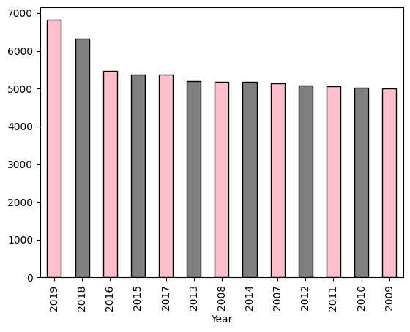
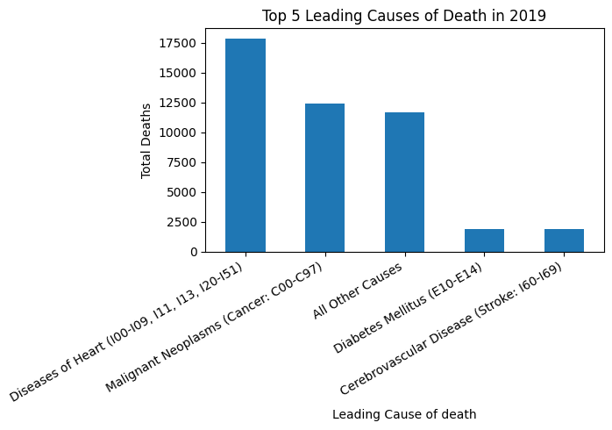
Findings
In the year 2019, the highest death rate was recorded. During this year, heart diseases stood out as the leading cause of deaths, while malignant neoplasms followed as the second most prevalent cause.

Slide 7
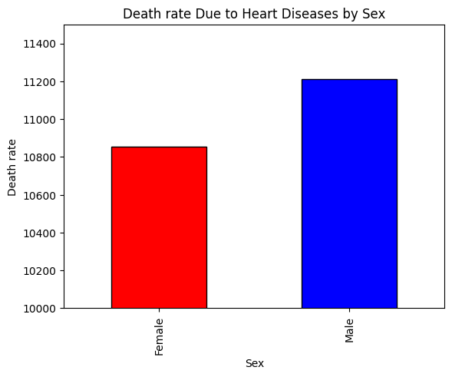
Throughout the study period spanning from 2009 to 2019, men consistently experienced a higher death rate attributed to heart diseases.

Slide 8
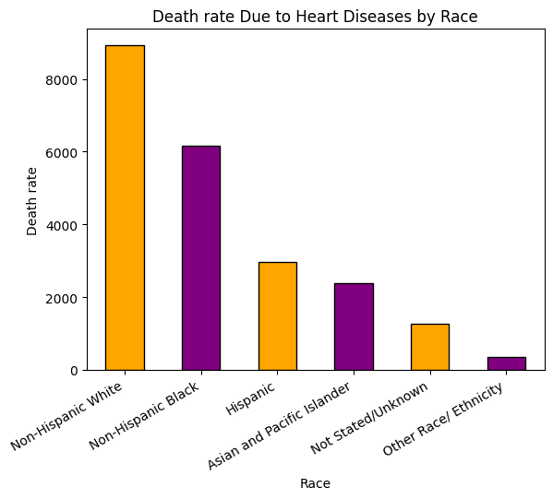
Throughout the years, the non-Hispanic white population registered the highest death rate attributed to heart disease.

Slide 9
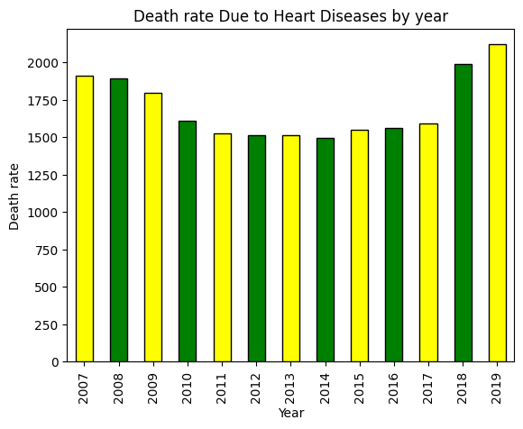
The death rate linked to heart disease has exhibited a pattern of wave-like fluctuations across the years, suggesting cyclical variations in its occurrence and impact.

Slide 10
Thank you for your time 😊

